Slide 1
ME2002: Mechanics of Materials Course
Project
Screw Jack
- T Venumadhava Reddy
ME22B1043

Slide 2
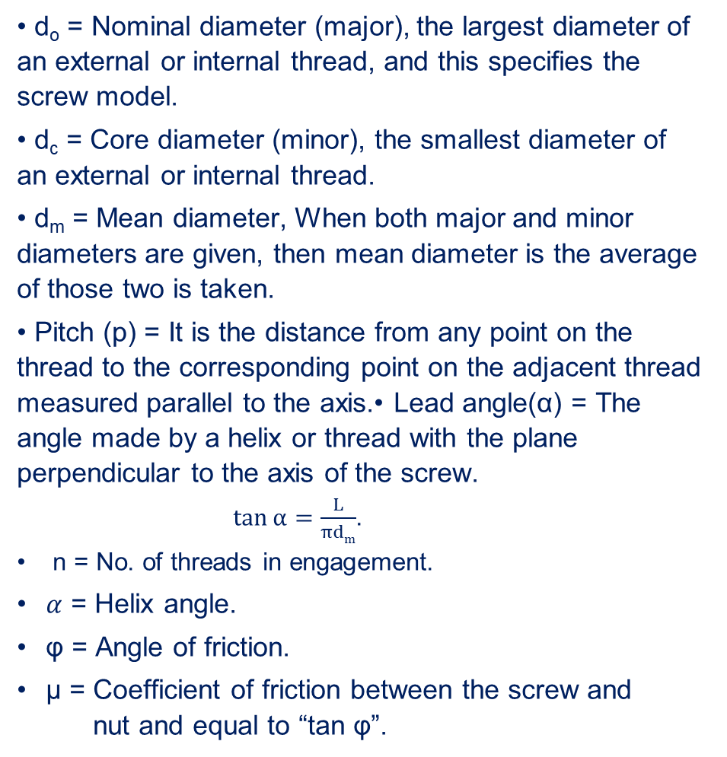
Terminology
Assumptions
• d_{o} = Nominal diameter (major), the largest diameter of an external or internal thread, and this specifies the screw model.
• d_{c} = Core diameter (minor), the smallest diameter of an external or internal thread.
• d_{m} = Mean diameter, When both major and minor diameters are given, then mean diameter is the average of those two is taken.
• Pitch (p) = It is the distance from any point on the thread to the corresponding point on the adjacent thread measured parallel to the axis.• Lead angle(α) = The angle made by a helix or thread with the plane perpendicular to the axis of the screw. $\tan{\text{α}}=\frac{L}{πdm}$.
n = No. of threads in engagement.
$α$ = Helix angle.
φ = Angle of friction.
μ = Coefficient of friction between the screw and nut and equal to “tan φ”.
Load: Compressive (no eccentric loading).
Screw Type: Single square threaded.
Load Direction: Horizontal force applied.
The load rotates with the screw so, no collar friction.
The material of the solid shaft is uniform throughout and the twist along the length of the shaft is uniform.
The normal cross-sections of the shaft, which were plane and circular before the twist, remain plane and circular after the twist.
All diameters of the normal cross-section which were straight before the twist, remain straight with their magnitude unchanged, after the twist.

Slide 3
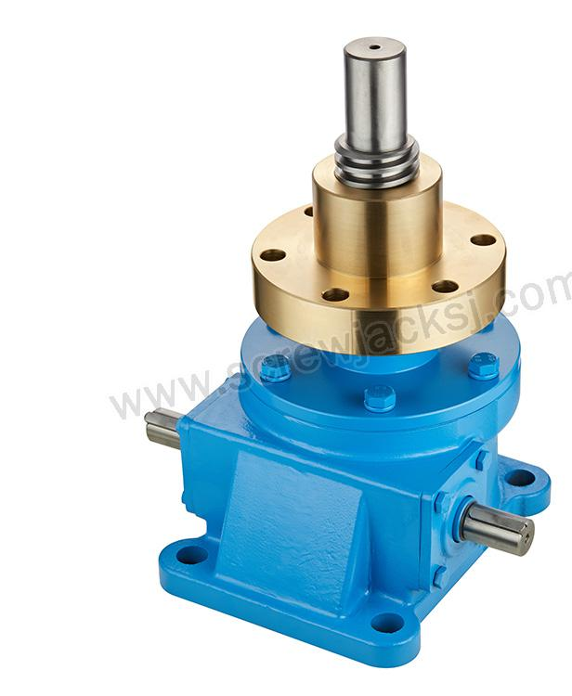
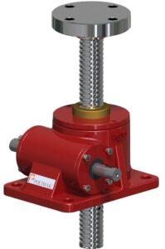
A screw jack is a device that uses a screw mechanism to lift or lower heavy loads by converting rotary motion into linear motion.
It consists of a threaded screw, a nut, and four links that form a parallelogram. It can be operated manually by a handle or crank, or electrically by a motor
There will be two cases of this usage:
Case 1: When the load is Lifting.
Case 2: When the load is lowering
A Normal Screw jack will contain the following parts:
Screwed spindle having square threaded screws
Nut and collar for nut
Head at the top of the screwed spindle for the handle
Cup at the top of the head for the load

Slide 4
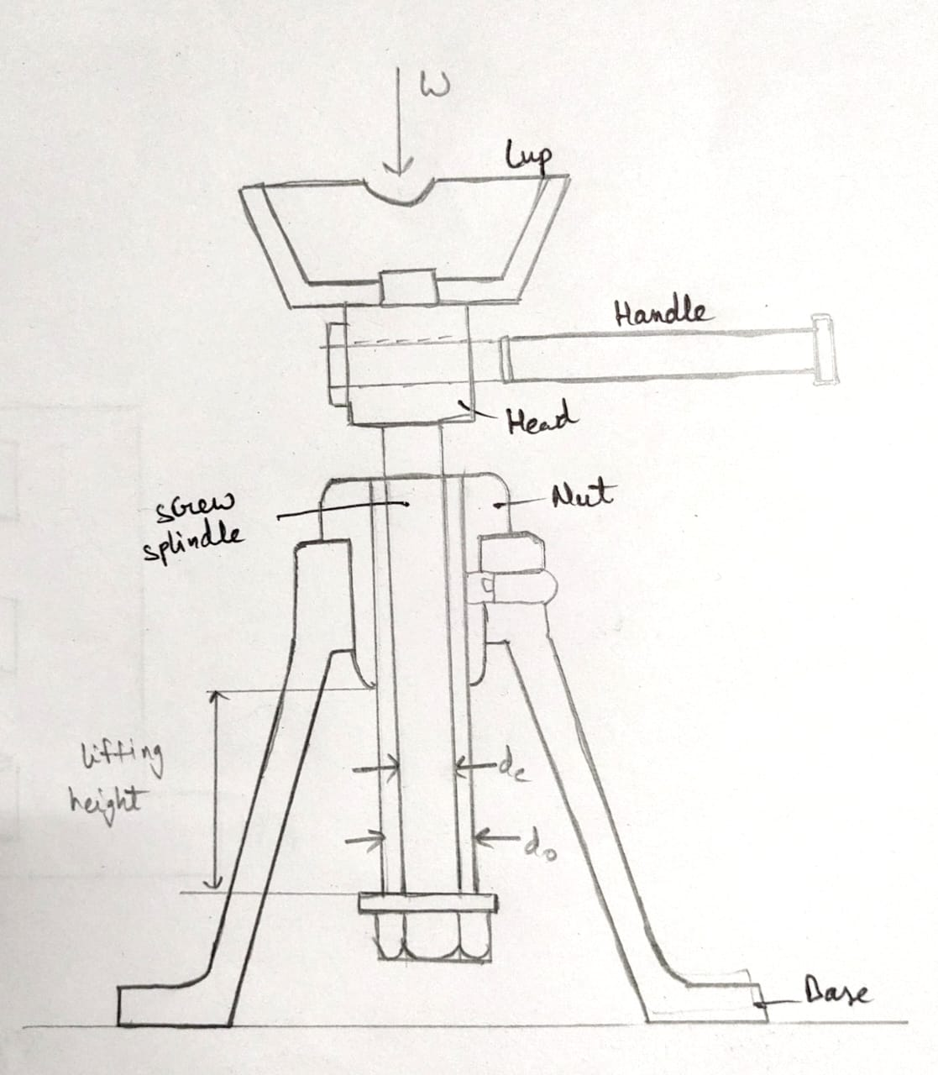
We are considering a screw jack powered by a motor as shown in the above picture, with the parts- Screw and nut.
We are considering that the one complete turn of a screw thread is imagined to be unwound, from the body of the screw and developed, it will form an inclined plane, since the principle, on which a screw jack works is similar to that of an inclined plane, therefore the force applied on the circumference of a screw jack may be considered to be horizontal as shown in the following analysis:

Slide 5
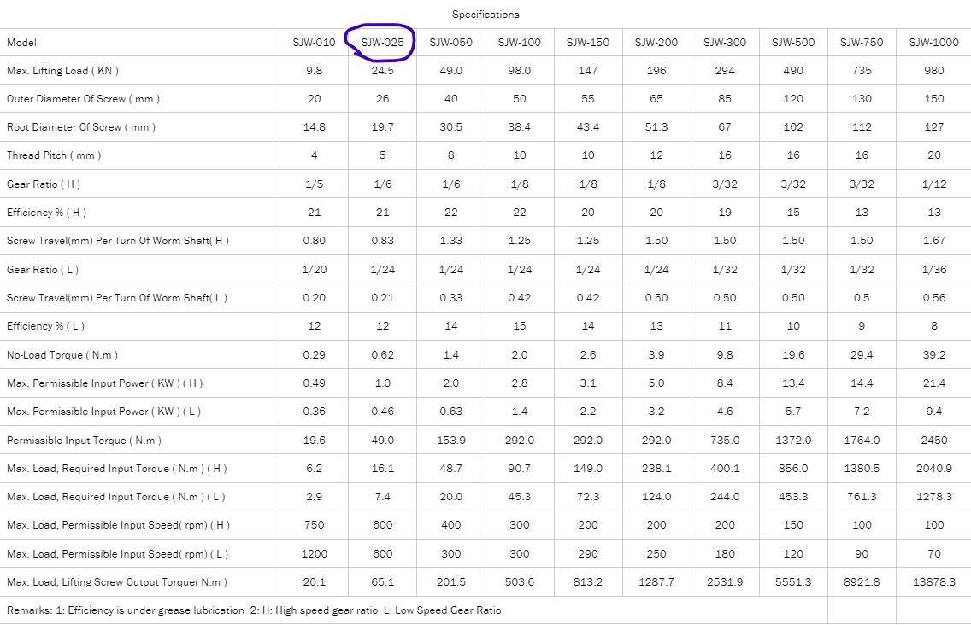
The product that is taken for analysis is from the “SIJIE Industrial” Model No. SJW-025.

Slide 6
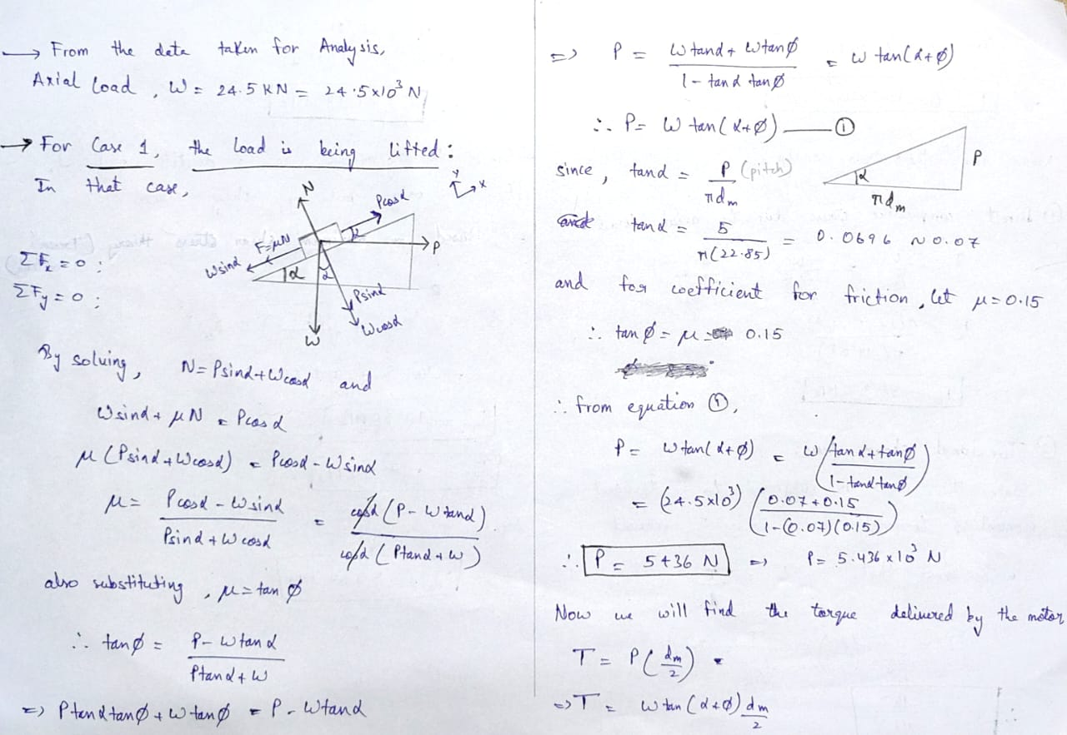
Case 1: When the load is Lifting.

Slide 7
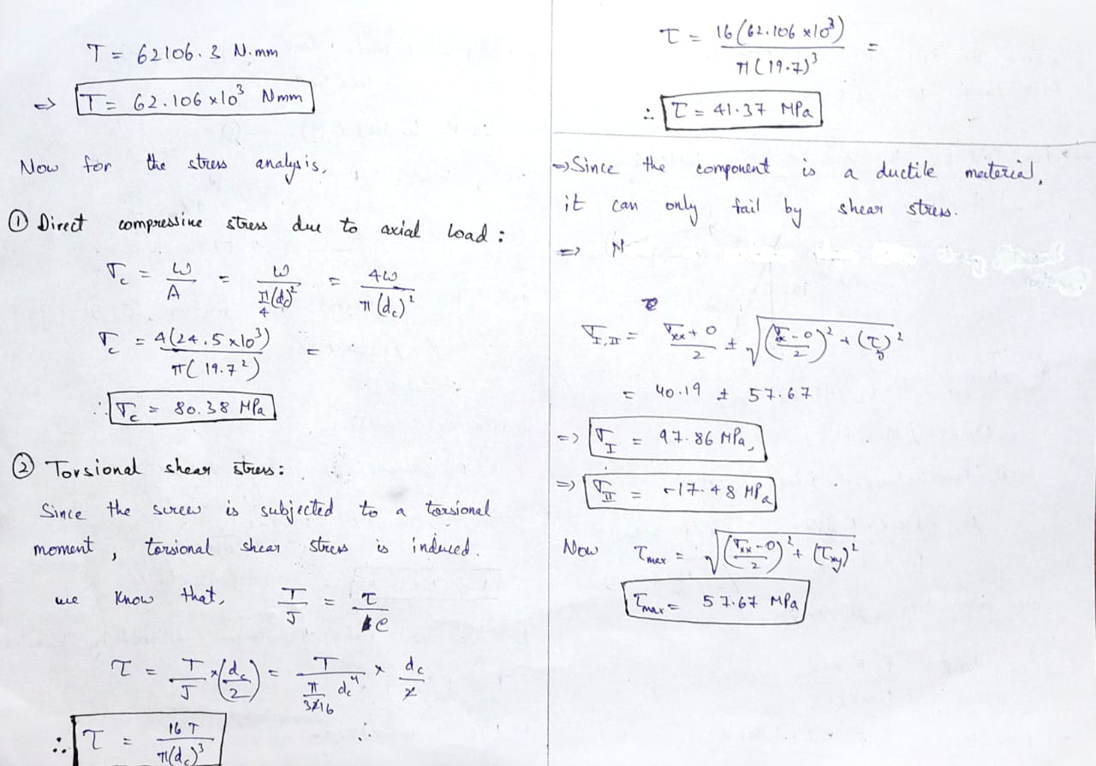
Case 1: When the load is Lifting.

Slide 8
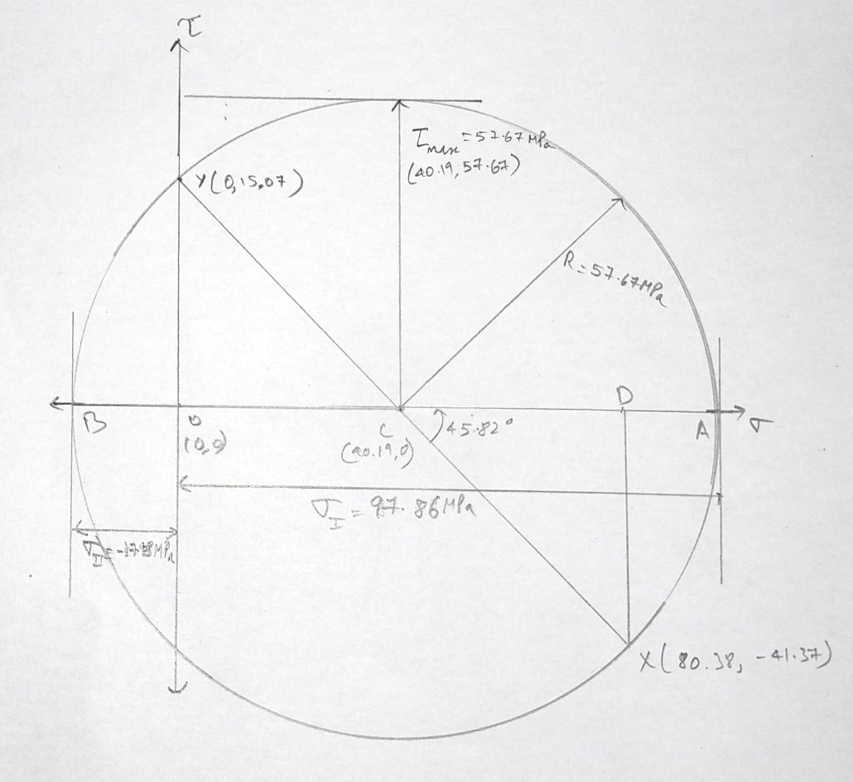
Mohr circle - 1

Slide 9
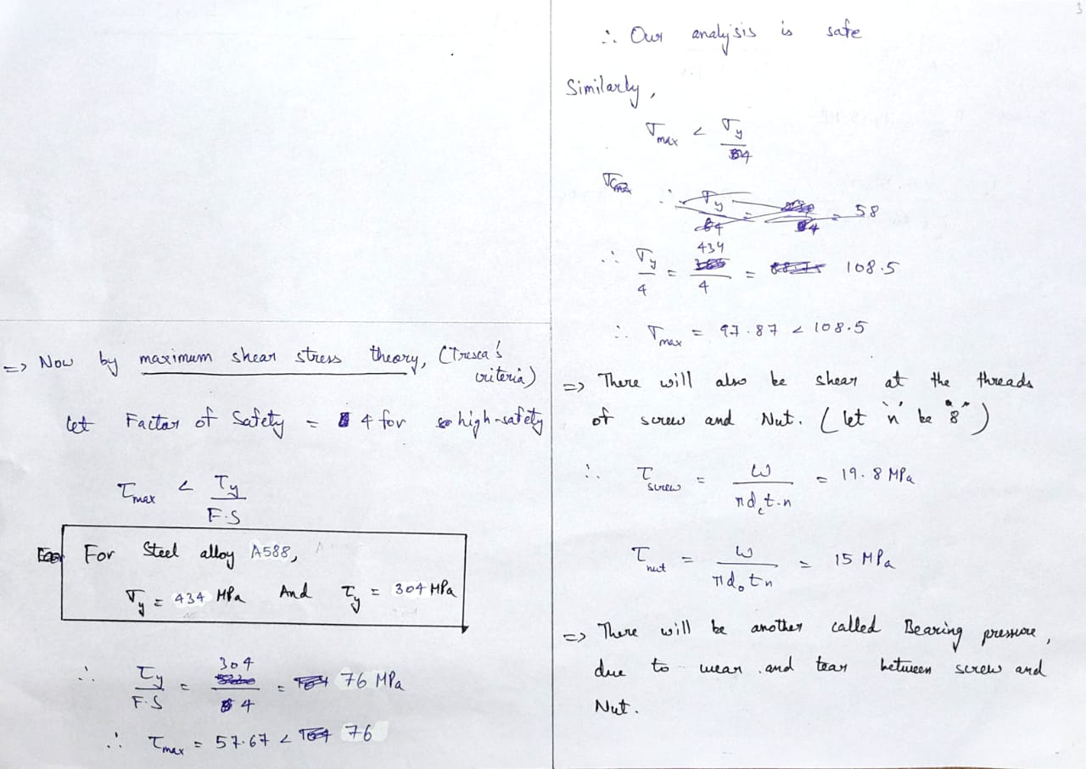
Case 1: When the load is Lifting.

Slide 10
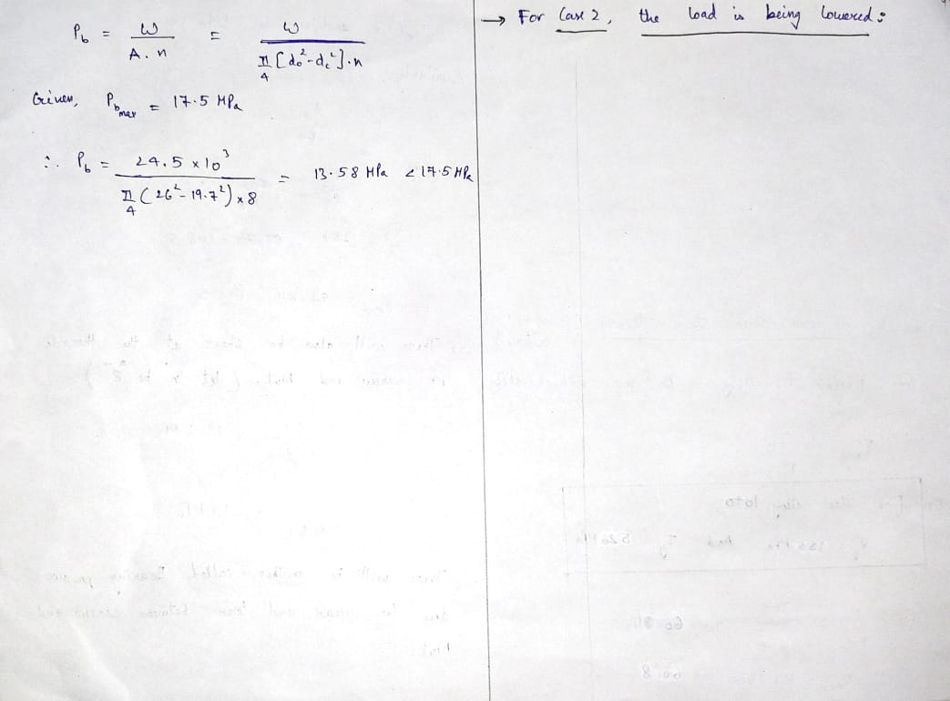
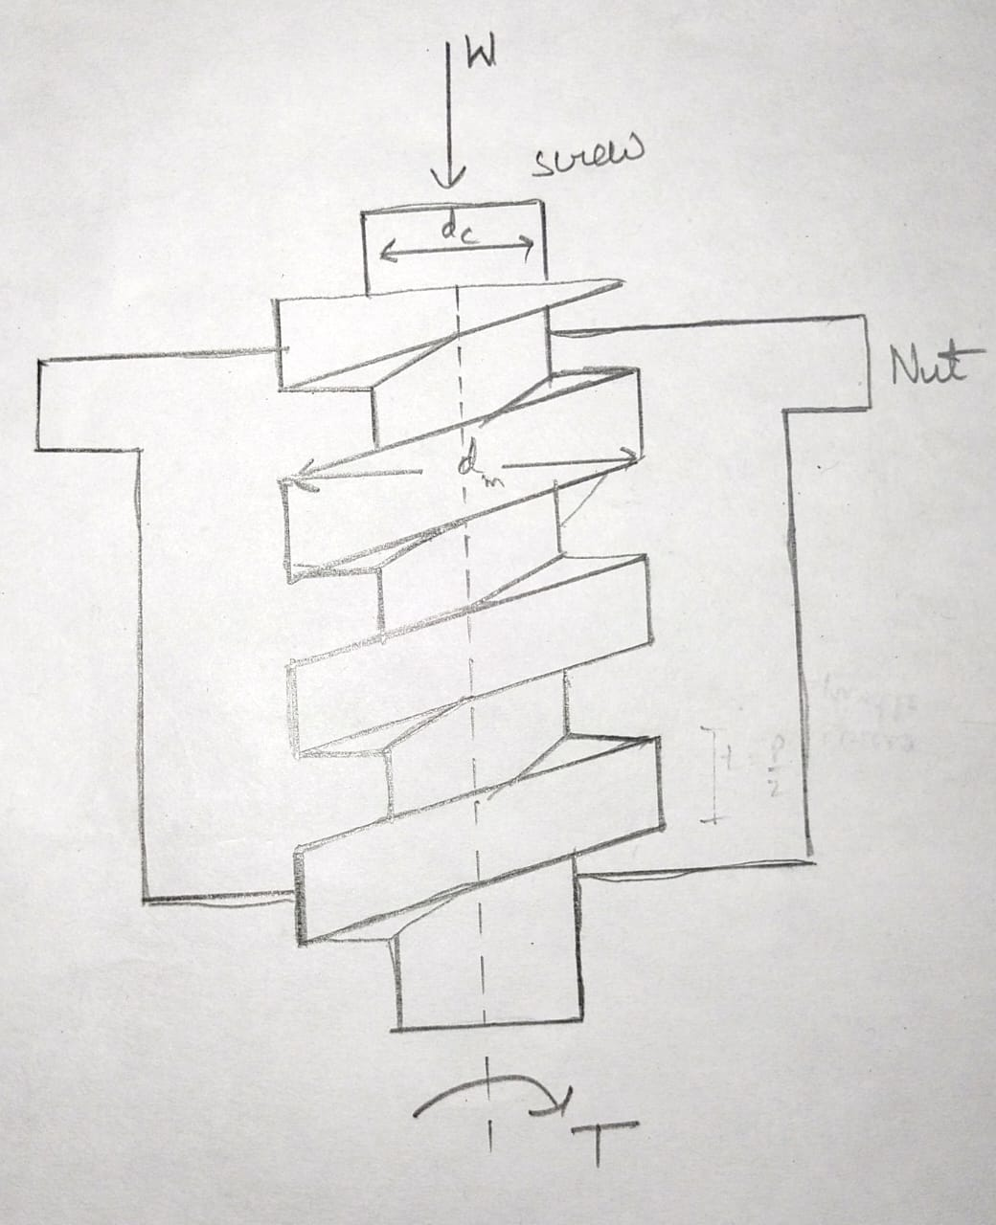
Case 1: When the load is Lifting.
Case 2: When the load is lowering.

Slide 11
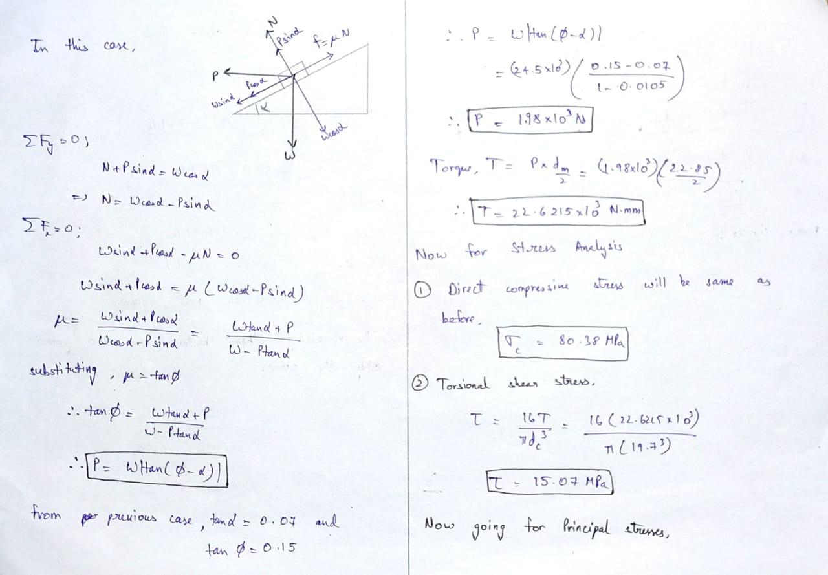
Case 2: When the load is lowering.

Slide 12
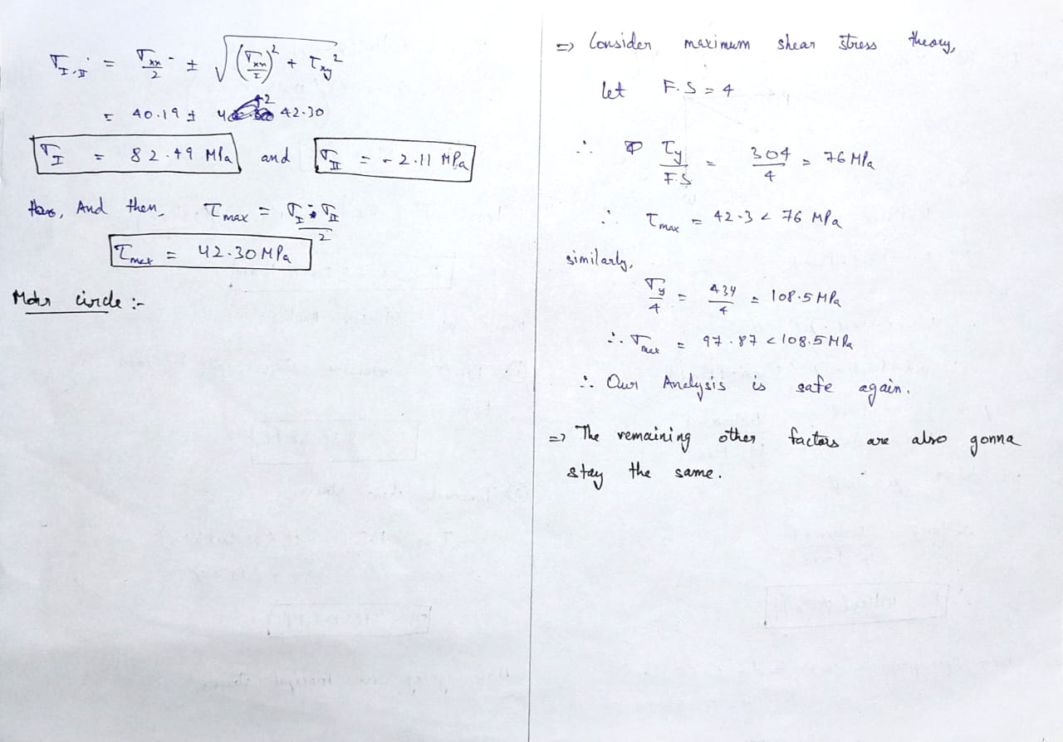
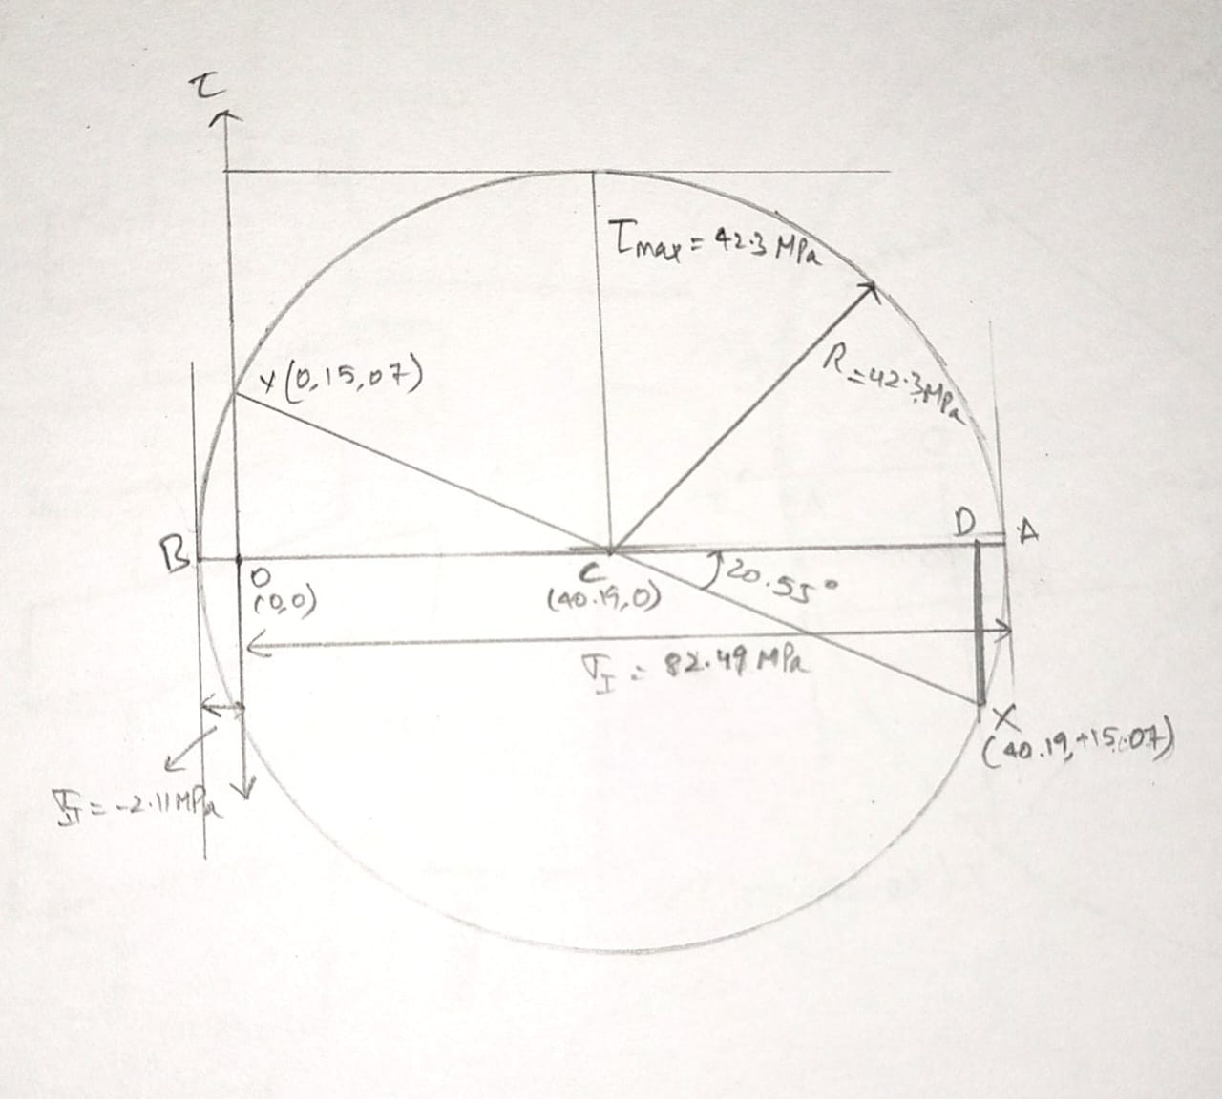
Case 2: When the load is lowering.
Mohr circle - 2

